Slide 1
Assignment 01 Data Complexity Reduction
Team 9
S5065623
S4302443
S5893836

Slide 2
Managerial question Methodology
How can Ixmor reduce the number of survey questions related to lifestyle and perceptions of organic/bio food to capture the most important factors influencing consumer behaviour?
The appropriate methodological approach to address this question is to perform an Exploratory Factor Analysis (EFA). PCA offers no help in understanding the importance of the variables, therefore, this project will use Exploratory Factor Analysis (EFA) in order to identify potential factors behind the variables. The process will begin with an examination of the correlations between the observed variables to assess the strength of their interrelationships. Following this, we will determine the optimal number of factors that best represent the data, using criteria such as eigenvalues and scree plots. Finally, we will interpret and label the identified factors, presenting factor loadings that reflect the extent to which each variable is associated with its corresponding factor. This approach will allow us to reduce the complexity of the survey while retaining its essential dimensions for capturing consumer behavior related to lifestyle and perceptions of organic/bio foods.

Slide 3
Analysis, Results and Managerial Advice - Lifestyle
Aim: To reduce the number of questions related to lifestyle, we performed an exploratory factor analysis and grouped the number of questions into a few factors.
1. Factor Analysis Appropriateness: We conducted the Kaiser-Meyer-Olkin (KMO) Test and Bartlett’s Test to assess whether the dataset was suitable for factor analysis.
KMO Test: The KMO value was 0.68 (Table3), a sufficient evident are supporting that there is common variance among variables.
Bartlett’s Test: Bartlett’s test was highly significant, with a p-value of 0.000, null hypothesis was rejected. This confirms that there is a significant common variance among the variables.
We concluded that the dataset is appropriate for factor analysis.
2. Initial Exploratory Results:
Scree Plot: The results from the scree plot (Graph 1) indicate a potential “elbow” after the second factor, which suggests that retaining 2 factor is sufficient.
Nscree: Depending on different methods the number of recommended factors is different, noc=2, naf= 1, nparallel=5, nkaiser=5 (Table1).
Eigenvalue Criterion: The Eigenvalue suggests that retaining 5 factors is sufficient, as 5 factors had eigenvalues greater than 1 (Table 2).
3. Rotation and Loadings Analysis: After the initial results, we conducted an oblique rotation to enhance the interpretability of the factor solution.
We try to analyze with multiple options of factor number. In the situation of 2 factors (Table 5.1), cumulative var=0.38, we considered that the two variables do not explain sufficient variance. In the situation of 5 and 4 factors (Table 5.2 &5.3), we found the loading of last factor smaller than 1 (0.828 & 0.795), therefore we decided to have 3 factors.
4. Results: We derived the loading table from the EFA, where factor 1 explains the most of the total variance (16.3%), factor 2 (13.1%) and factor 3 (12.2%) (Table 4). In total, the three factors explained 41.5% of the total variance. Combining heatmap (Graph2) and SEM path (Graph3), we can see the contribution of each variable to the factors, for factor 1, Q20, Q21, Q22, Q12 and Q16 have large contribution. For factor 2, Q16, Q23, Q11, Q14 have large contribution. For factor 3, questions Q17, Q13, Q12 have large contribution.
5. Managerial Advice
In summary, we would recommend that Ixmør's managers use the questions Q20, Q14 and Q13 to measure consumers' lifestyles.
Q20 had a highest loading on Factor 1 (0.819), suggesting that this Factor 1 may be related to an open-mindedness about things.
Q14 had the highest loading on Factor 2 (0.978), suggesting that Factor 2 may be highly correlated with passionate about cooking.
Q13 had the highest loading on Factor 3 (0.787), suggesting that Factor 3 may be correlated with the social conformity concepts.

Slide 4
Analysis, Results and Managerial Advice - Perception of Organic/bio Food
Aim: To reduce the number of questions related to perceptions of organic/bio food, we performed an exploratory factor analysis and grouped the number of questions into a few factors.
1. Factor Analysis Appropriateness: We conducted the Kaiser-Meyer-Olkin (KMO) Test and Bartlett’s Test to assess whether the dataset was suitable for factor analysis.
KMO Test: The KMO value was 0.731, suggesting that the variables share enough common variance to proceed with the analysis.
Bartlett’s Test: Bartlett’s test was highly significant, with a p-value of 0.000, allowing us to reject the null hypothesis. This confirms that there is a significant common variance among the variables.
Given these results, we can conclude that the dataset is appropriate for factor analysis.
2. Initial Exploratory Results:
Scree Plot: The results from the scree plot (Graph 4) indicate a potential “elbow” after the first factor, which suggests that retaining 1 factor is sufficient. However, using only 1 factor might underestimate the dimensionality of the data.
Eigenvalue Criterion: The Eigenvalue criterion suggests that retaining 4 factors is sufficient, as four factors had eigenvalues greater than 1(Table 6). However, while this criterion is useful, it can overestimate the number of factors, given that the results from the scree plot suggested only 1 factor.
3. Rotation and Loadings Analysis: After the initial results, we conducted an oblique rotation to enhance the interpretability of the factor solution.
The results from the rotation evaluated the SS loading for each factor. Based on the eigenvalue criteria, a four-factor model was initially tested (see Table 7). However, the fourth factor had SS loadings below 1, indicating that it did not account for sufficient variance to be considered significant.
Subsequently. the model was reduced to a three-factor model, yielding the results presented in Table 8. The SS loadings for all three factors were above 1, indicating that each factor explained a significant portion of the total variance. Based on these considerations, we chose a three-factor model for our exploratory factor analysis.
4. Results: After performing an exploratory factor analysis on the set of questions related to perceptions of organic/bio foods, three distinct factors emerged that effectively grouped the variables. These factors were identified as Factor 1 – Knowledge of Organic/Bio Foods, Factor 2 – Perceived Lack of Knowledge, and Factor 3 – Perceived Ease of Access and Control. Specifically, Factor 1 encompasses Q24, Q25, Q27, and Q33, reflecting respondents' knowledge and expertise regarding organic/bio foods. Factor 2 includes Q26, Q28, and Q29, capturing perceptions of a lack of knowledge. Finally, Factor 3 groups Q30, Q31, and Q34, representing perceptions of ease and control over the ability to purchase organic/bio foods. All these variables (questions) have loadings greater than 0.4, hence we can say that these variables are strongly associated with these factors. (see Graph 5)
5. Managerial Advice
The manager can streamline decision-making by focusing on the three identified factors—Factor 1: Knowledge of Organic/Bio Foods, Factor 2: Perceived Lack of Knowledge, and Factor 3: Perceived Ease of Access and Control—rather than evaluating each of the 11 individual questions separately.

Slide 5
Comments On AI Comparison:
We chose to keep our original drafts and not go with the ChatGPT versions
The reason for this is that, although ChatGPT captured the general message of our analysis, some explanations and nuance was omitted from the GPT version, therefore we decided to keep our original draft. We believe that our readability is not a problem, and that chatgpt removes some important explanations and humanity from the project. A manager would not necessarily understand the ins and outs of data processing so they would benefit from a more human explanation otherwise they may get overwhelmed by all the numbers.
In terms of coding, we asked GPT for advice on errors we got and how to fix it if it was not something that our teammates knew either. An example of such a question is: “We keep getting error X when attempting to do an oblique rotation. Can you help troubleshoot what the problem is?” or “For these questions below, please reorder them and let us know what questions fit into each group based on this: group 1: Q20, Q21, Q22, Q12, and Q16 group 2: …. “
We generally followed the template of the R code already provided to us so we did not need much advice on coming up with code ourselves this time around.

Slide 6
APPENDIX 1. R Code (lifestyle)
group9 <- SLIM2425a_team_9_glm
##########Life style############
ls <- group9[,11:23]
ls.sd <- data.frame(scale(ls))
summary(ls.sd)
library(nFactors)
nScree(ls.sd) #recommended factor num 1-2
eigen(cor(ls.sd)) #regards to eigenvalue, 5 factors recommended
library(corrplot)
corrplot(cor(ls.sd), order="hclust")
plot(prcomp(ls.sd),type="l")
kmo <- function(x){
x <- subset(x, complete.cases(x))
r <- cor(x)
r2 <- r^2
i <- solve(r)
d <- diag(i)
p2 <- (-i/sqrt(outer(d, d)))^2
diag(r2) <- diag(p2) <- 0
KMO <- sum(r2)/(sum(r2)+sum(p2))
MSA <- colSums(r2)/(colSums(r2)+colSums(p2))
return(list(KMO=KMO, MSA=MSA))
}
kmo(ls.sd) #KMO=0.68, proportion of variability among variables that might be common variability
bartlett.sphere<-function(data){chi.square=-( (dim(data)[1]-1) -
(2*dim(data)[2]-5)/6 )*
log(det(cor(data,use='pairwise.complete.obs')));cat('chi.square value ',
chi.square , ' on ', (dim(data)[2]^2-dim(data)[2])/2, ' degrees of freedom.'
, ' p-value: ', 1-pchisq(chi.square,(dim(data)[2]^2-dim(data)[2])/2))}
bartlett.sphere(ls.sd) #p-value: 0, H0 rejected, common variance among variables
edge.label.cex=0.75, nCharNodes=7)
library(GPArotation)
(ls.sd.ob <- factanal(ls.sd, factors=3, rotation="oblimin"))
library(gplots)
library(RColorBrewer)
heatmap.2(ls.sd.ob$loadings,
col=brewer.pal(9, "YlOrRd"), trace="none", key=FALSE, dend="none",
Colv=FALSE, cexCol = 1.2,
main="\n\n\n\n\nFactor loadings for brand adjectives")
library(semPlot)
semPaths(ls.sd.ob, what="est", residuals=FALSE,
cut=0.3, posCol=c("white", "darkgreen"), negCol=c("white", "red"),
edge.label.cex=0.75, nCharNodes=7)

Slide 7
APPENDIX 1. R Code (bio food perception)
###### perception of bio food######
pc <- group9[,24:34]
pc.sd <- data.frame(scale(pc))
summary(pc.sd)
library(nFactors)
nScree(pc.sd) #recommended factor num 1-2
eigen(cor(pc.sd)) #regards to eigenvalue, 5 factors recommended
library(corrplot)
corrplot(cor(pc.sd), order="hclust")
plot(prcomp(pc.sd),type="l")
kmo <- function(x){
x <- subset(x, complete.cases(x))
r <- cor(x)
r2 <- r^2
i <- solve(r)
d <- diag(i)
p2 <- (-i/sqrt(outer(d, d)))^2
diag(r2) <- diag(p2) <- 0
KMO <- sum(r2)/(sum(r2)+sum(p2))
MSA <- colSums(r2)/(colSums(r2)+colSums(p2))
return(list(KMO=KMO, MSA=MSA))
}
kmo(pc.sd) #KMO=0.73, proportion of variability among variables that might be common variability
bartlett.sphere<-function(data){chi.square=-( (dim(data)[1]-1) -
(2*dim(data)[2]-5)/6 )*
log(det(cor(data,use='pairwise.complete.obs')));cat('chi.square value ',
chi.square , ' on ', (dim(data)[2]^2-dim(data)[2])/2, ' degrees of freedom.'
, ' p-value: ', 1-pchisq(chi.square,(dim(data)[2]^2-dim(data)[2])/2))}
bartlett.sphere(pc.sd) #p-value: 0, H0 rejected, common variance among variables
library(GPArotation)
(pc.sd.ob <- factanal(pc.sd, factors=3, rotation="oblimin"))
library(gplots)
library(RColorBrewer)
heatmap.2(pc.sd.ob$loadings,
col=brewer.pal(9, "YlOrRd"), trace="none", key=FALSE, dend="none",
Colv=FALSE, cexCol = 1.2,
main="\n\n\n\n\nFactor loadings for brand adjectives")
library(semPlot)
semPaths(pc.sd.ob, what="est", residuals=FALSE,
cut=0.3, posCol=c("white", "darkgreen"), negCol=c("white", "red"),
edge.label.cex=0.75, nCharNodes=7)

Slide 8
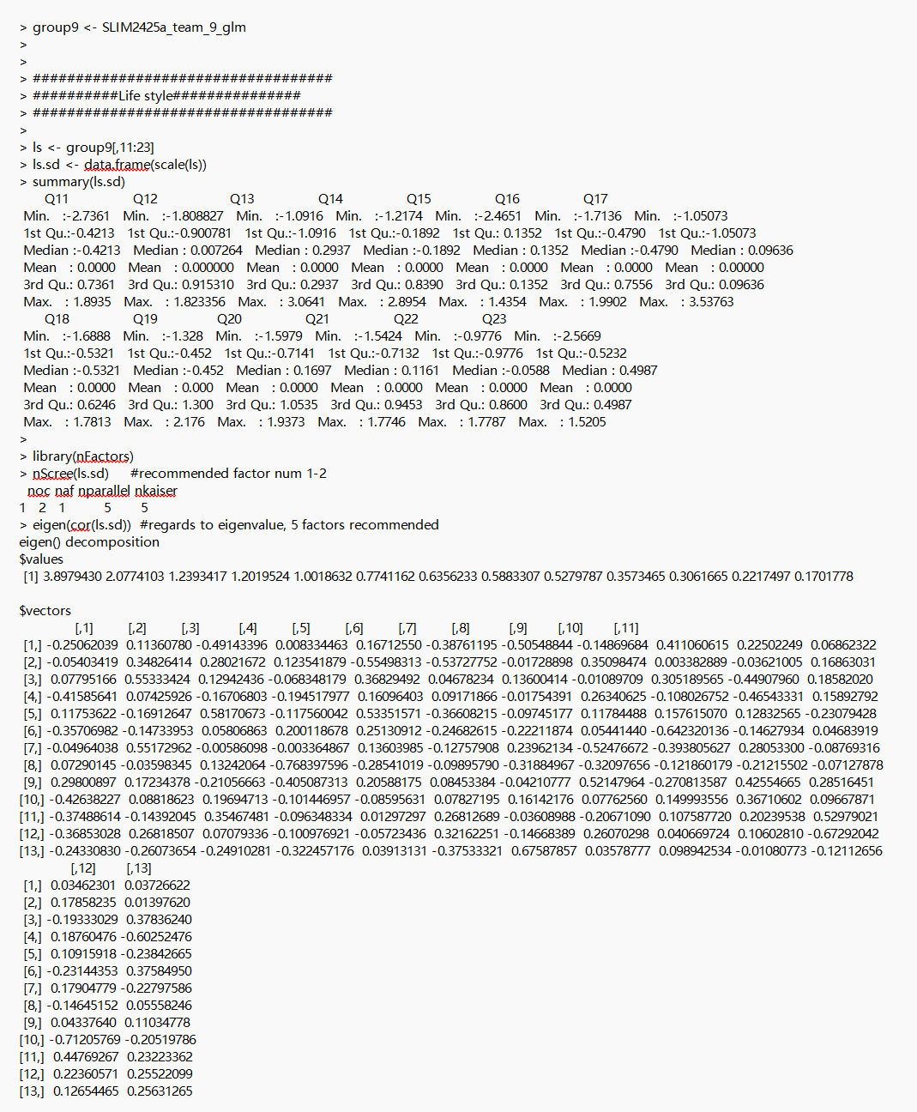
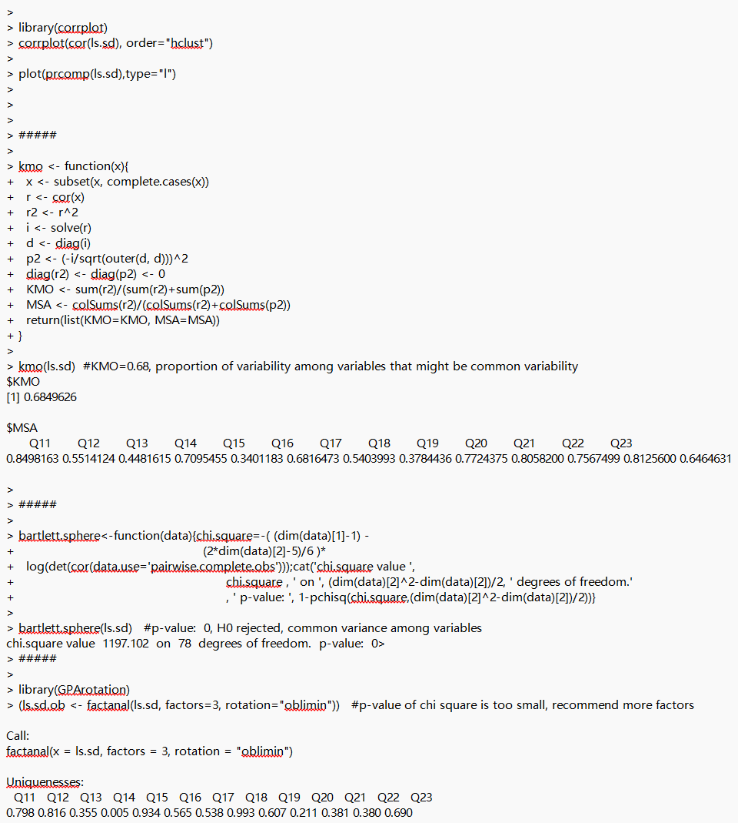
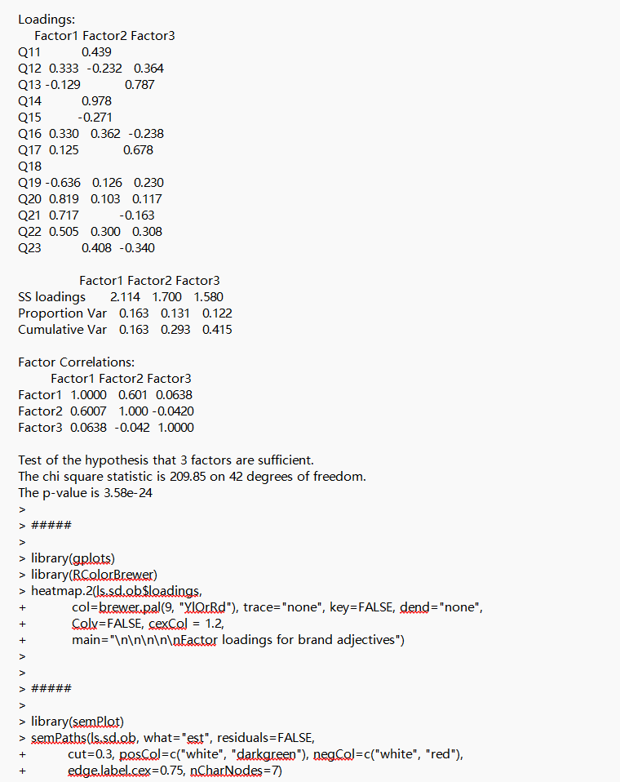
APPENDIX 2. Coding output

Slide 9
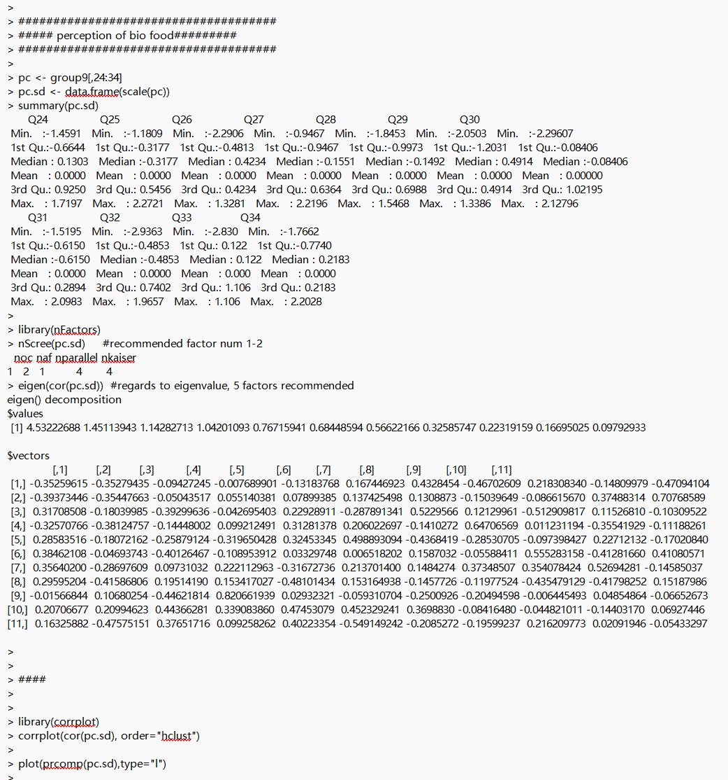
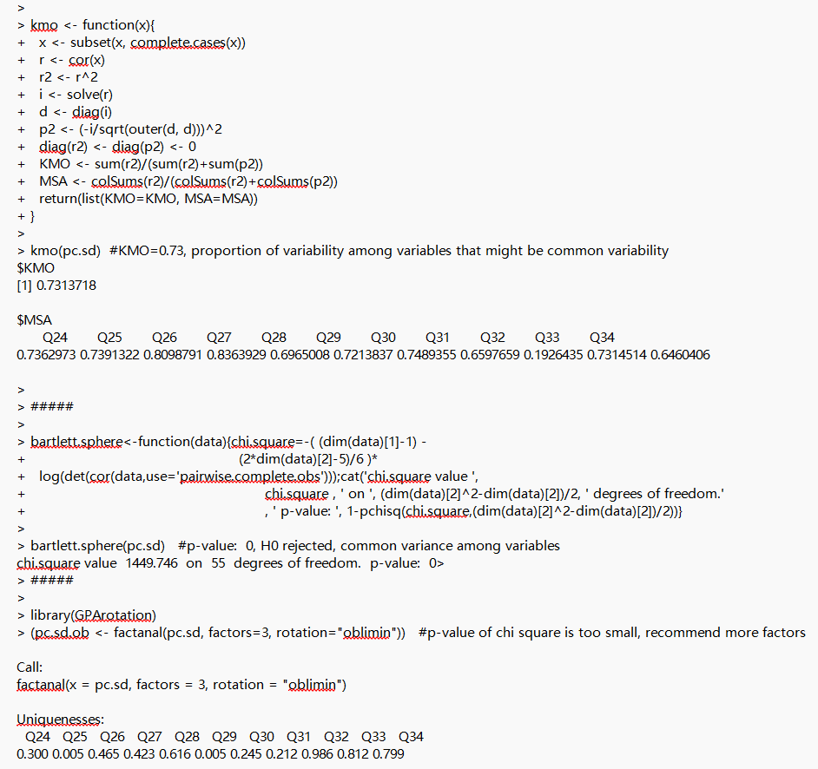
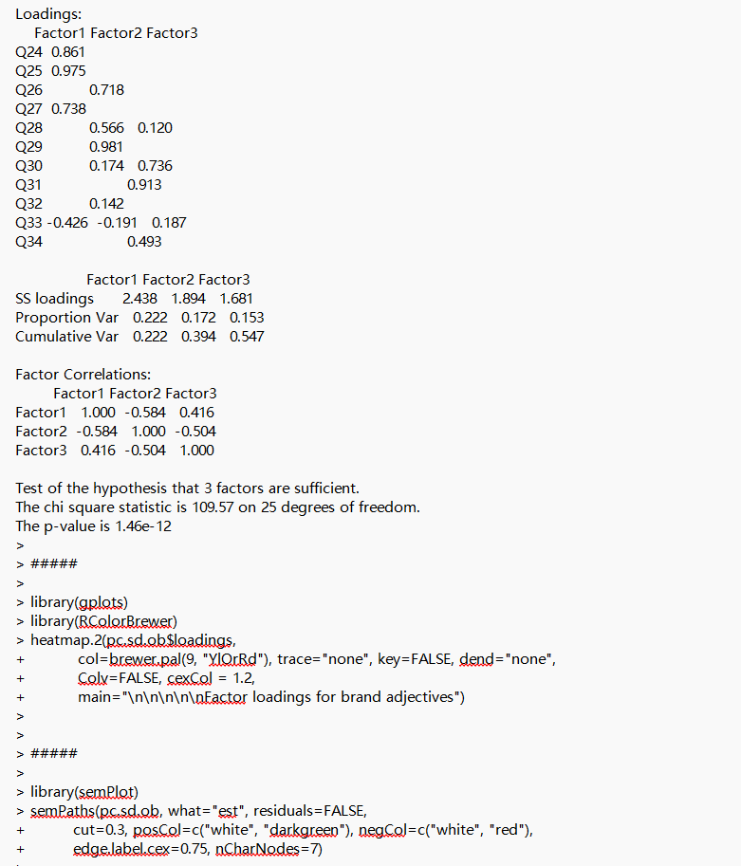
APPENDIX 2. Coding output

Slide 10
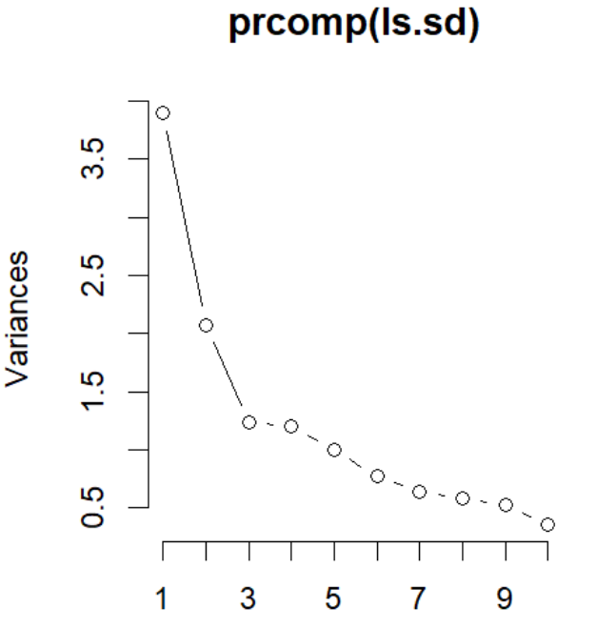
Appendix 2
Graph 1
Scree Plot: Lifestyle

Slide 11
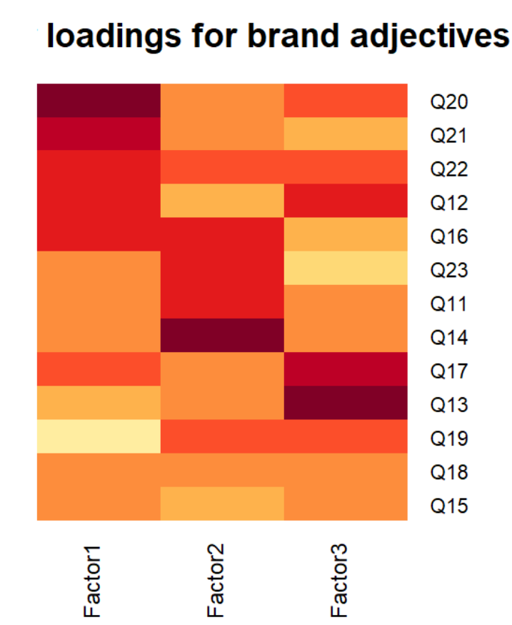
Appendix 2
Graph 2
Heatmap: Lifestyle

Slide 12
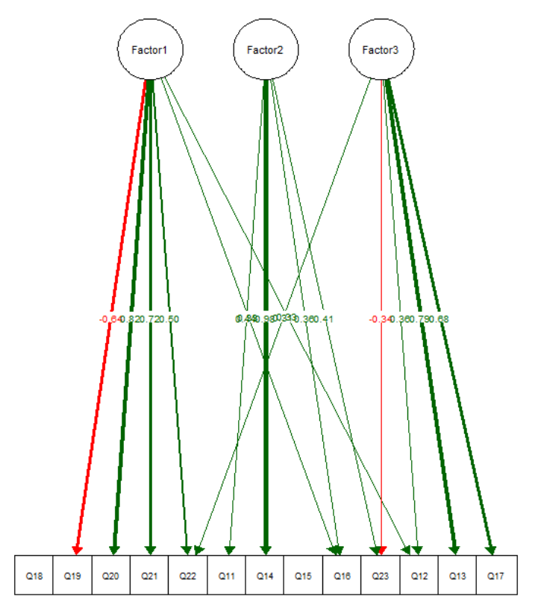
Appendix 2
Graph 3
SEM path: Lifestyle

Slide 13
Appendix 2
Table 1
nScree: Lifestyle
noc | naf | nparallel | nkaiser
2 | 1 | 5 | 5

Slide 14
Appendix 2
Eigenvalue
3.89794
2.07741
1.23934
1.20195
1.00186
0.77412
0.63562
0.58833
0.52798
0.35735
0.30617
0.22175
0.17018
Table 2
Eigenvalue: Lifestyle

Slide 15
Appendix 2
 | MSA
Q11 | 0.8498163
Q12 | 0.5514124
Q13 | 0.4481615
Q14 | 0.7095455
Q15 | 0.3401183
Q16 | 0.6816473
Q17 | 0.5403993
Q18 | 0.3784436
Q19 | 0.7724375
Q20 | 0.8058200
Q21 | 0.7567499
Q22 | 0.8125600
Q23 | 0.6464631
Table 3
KMO: Lifestyle
KMO
0.6849626

Slide 16
Appendix 2
Loadings
 | Factor1 | Factor2 | Factor3
Q11 |  | 0.439
Q12 | 0.333 | -0.232 | 0.364
Q13 | -0.129 |  | 0.787
Q14 |  | 0.978
Q15 |  | -0.271
Q16 | 0.330 | 0.362 | -0.238
Q17 | 0.125 |  | 0.678
Q18
Q19 | -0.636 | 0.126 | 0.230
Q20 | 0.819 | 0.103 | 0.117
Q21 | 0.717 |  | -0.163
Q22 | 0.505 | 0.300 | 0.308
Q23 |  | 0.408 | -0.340
Table 4
Loadings: Lifestyle
 | Factor1 | Factor2 | Factor3
SS loadings | 2.114 | 1.700 | 1.580
Proportion Var | 0.163 | 0.131 | 0.122
Cumulative Var | 0.163 | 0.293 | 0.415

Slide 17
Appendix 2
Table: 5.1. Loadings of 2 factors
 | factor1 | factor2
ss loadings | 3.396 | 1.575
Proportion Var | 0.261 | 0.121
Cumulative Var | 0.261 | 0.382
Table 5
EFA results when
2 & 4 & 5 factors
: Lifestyle
Table: 5.2. Loadings of 4 factors
 | factor1 | factor2 | factor3 | factor4
ss loadings | 2.062 | 1.633 | 1.554 | 0.795
Proportion Var | 0.159 | 0.126 | 0.12 | 0.061
Cumulative Var | 0.159 | 0.284 | 0.404 | 0.465
Table: 5.3. Loadings of 5 factors
 | factor1 | factor2 | factor3 | factor4 | factor5
ss loadings | 1.896 | 1.564 | 1.261 | 1.204 | 0.828
Proportion Var | 0.146 | 0.12 | 0.097 | 0.093 | 0.064
Cumulative Var | 0.146 | 0.266 | 0.363 | 0.456 | 0.519

Slide 18
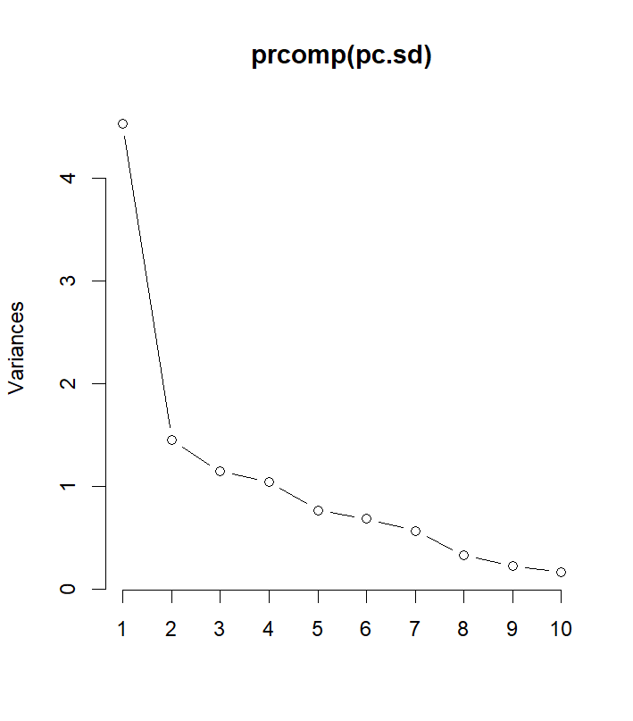
Appendix 2
Graph 4
Scree Plot: Perceptions of Organic/Bio Food

Slide 19
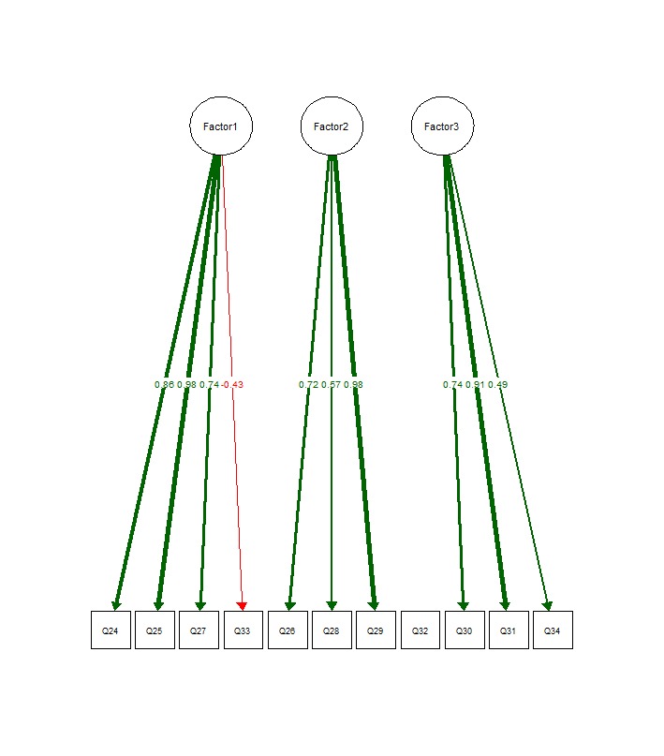
Appendix 2
Graph 5
Three-Factor Loading: Perceptions of Organic/Bio Food

Slide 20
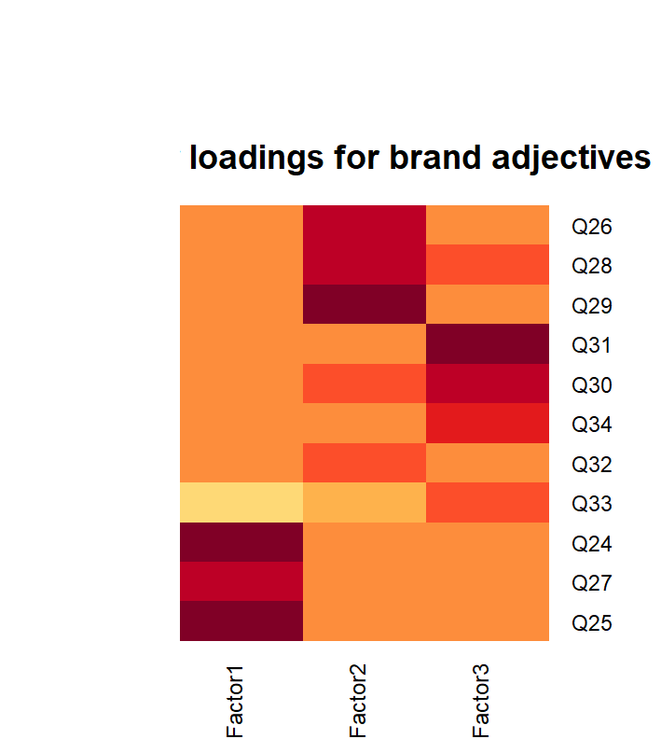
Graph 6
Heatmap: Perceptions of Organic/Bio Food

Slide 21
Appendix 2
Factor | EigenValues
Factor 1 | 4.532
Factor 2 | 1.451
Factor 3 | 1.143
Factor 4 | 1.042
Factor 5 | 0.767
Factor 6 | 0.684
Factor 7 | 0.566
Factor 8 | 0.326
Factor 9 | 0.223
Factor 10 | 0.167
Factor 11 | 0.098
Table 6
Eigenvalue Table for Factors
(Perception of Organic/Bio Food)

Slide 22
Appendix 2
Table 7
Factor Analysis Summary Table
(4 Factors)
Perception of Organic/Bio Food
 | Factor 1 | Factor 2 | Factor 3 | Factor 4
SS loadings | 1.917 | 1.669 | 1.346 | 0.945
Proportion var | 0.174 | 0.152 | 0.222 | 0.086
Cumulative var | 0.174 | 0.326 | 0.448 | 0.534

Slide 23
Appendix 2
Table 8
Factor Analysis Summary Table
(3 Factors)
Perceptions of Organic/Bio Food
 | Factor 1 | Factor 2 | Factor 3
SS loadings | 2.438 | 1.894 | 1.681
Proportion var | 0.222 | 0.172 | 0.153
Cumulative var | 0.222 | 0.394 | 0.547

Slide 24
APPENDIX 3. Draft Advices Comparison - Lifestyle (ChatGPT)
Exploratory Factor Analysis on Lifestyle Questions
Data Preparation and Suitability for EFA We extracted columns 11 to 23 from the dataset, representing lifestyle-related questions. The data was standardized, and its suitability for factor analysis was confirmed using the Kaiser-Meyer-Olkin (KMO) test (KMO = 0.68) and Bartlett’s test (p-value < 0.05), indicating sufficient common variance among the variables.
Factor Retention and Rotation After conducting the scree plot and eigenvalue analysis, different methods suggested retaining between 1, 2, or 5 factors. Initial analysis of 2 factors showed insufficient explained variance (cumulative variance = 38%). In models with 4 or 5 factors, the last factor had loadings below 1, prompting us to discard it. We settled on a 3-factor solution, using oblimin rotation. Visualization was completed using heatmaps and SEMpath.
Results The exploratory factor analysis (EFA) revealed that Factor 1 explains 16.3% of the variance, Factor 2 accounts for 13.1%, and Factor 3 contributes 12.2%, for a combined total of 41.5%. A detailed review of the contributions showed:
Factor 1: Q20, Q21, Q22, Q12, and Q16 had high loadings, indicating their significant contribution.
Factor 2: Q16, Q23, Q11, and Q14 were key contributors.
Factor 3: Q17, Q13, and Q12 had the strongest loadings.
Managerial Recommendations We recommend that Ixmør's managers focus on Q20, Q14, and Q13 for measuring consumer lifestyles:
Q20 (loading: 0.819) suggests a factor related to open-mindedness.
Q14 (loading: 0.978) suggests a factor connected to passion for cooking.
Q13 (loading: 0.787) relates to social conformity in food choices.

Slide 25
APPENDIX 3. Draft Advices Comparison - Perception (ChatGPT)
Exploratory Factor Analysis on Organic/Bio Food Perceptions
Data Suitability for EFA To analyze perceptions of organic/bio foods, we conducted the Kaiser-Meyer-Olkin (KMO = 0.731) and Bartlett’s tests (p-value = 0.000), confirming sufficient common variance among variables, making the dataset suitable for exploratory factor analysis.
Initial Results and Factor Retention The scree plot indicated an "elbow" after the first factor, but the eigenvalue criterion suggested retaining 4 factors (eigenvalues > 1). A four-factor model was tested, but the fourth factor's loadings were too low. We refined the model to a three-factor solution, which had strong SS loadings for each factor, all above 1.
Results The EFA revealed three distinct factors:
Factor 1 – Knowledge of Organic/Bio Foods: (Q24, Q25, Q27, Q33) reflects knowledge and expertise.
Factor 2 – Perceived Lack of Knowledge: (Q26, Q28, Q29) captures reverse-coded perceptions of a lack of knowledge.
Factor 3 – Perceived Ease of Access and Control: (Q30, Q31, Q34) relates to ease and control over purchasing organic/bio foods. Each factor had loadings above 0.4, indicating strong associations with the respective variables.
Managerial Recommendations To streamline decision-making, we recommend focusing on the three identified factors:
Factor 1: Knowledge of Organic/Bio Foods
Factor 2: Perceived Lack of Knowledge
Factor 3: Perceived Ease of Access and Control This approach reduces complexity by analyzing broader themes rather than individual questions.

